Slide 1

Modelling Anthropogenic Climate Change
By Thomas Davies
Department of Physics | Durham University
January 2024

Slide 2
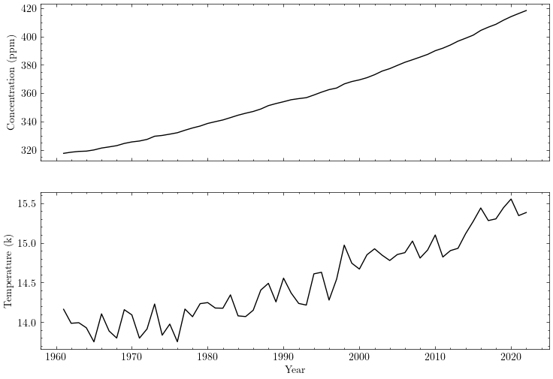
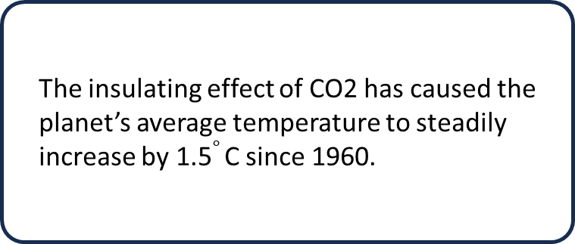
CO2 Atmospheric Concentration
The industrial revolution (circ. 1750) caused a significant increase in demand for energy, leading to the mass burning of coal, and a steady increase in atmospheric CO2 from 280ppm up to 420ppm today.
The insulating effect of CO2 has caused the planet’s average temperature to steadily increase by 1.5$∘$ C since 1960.

Slide 3
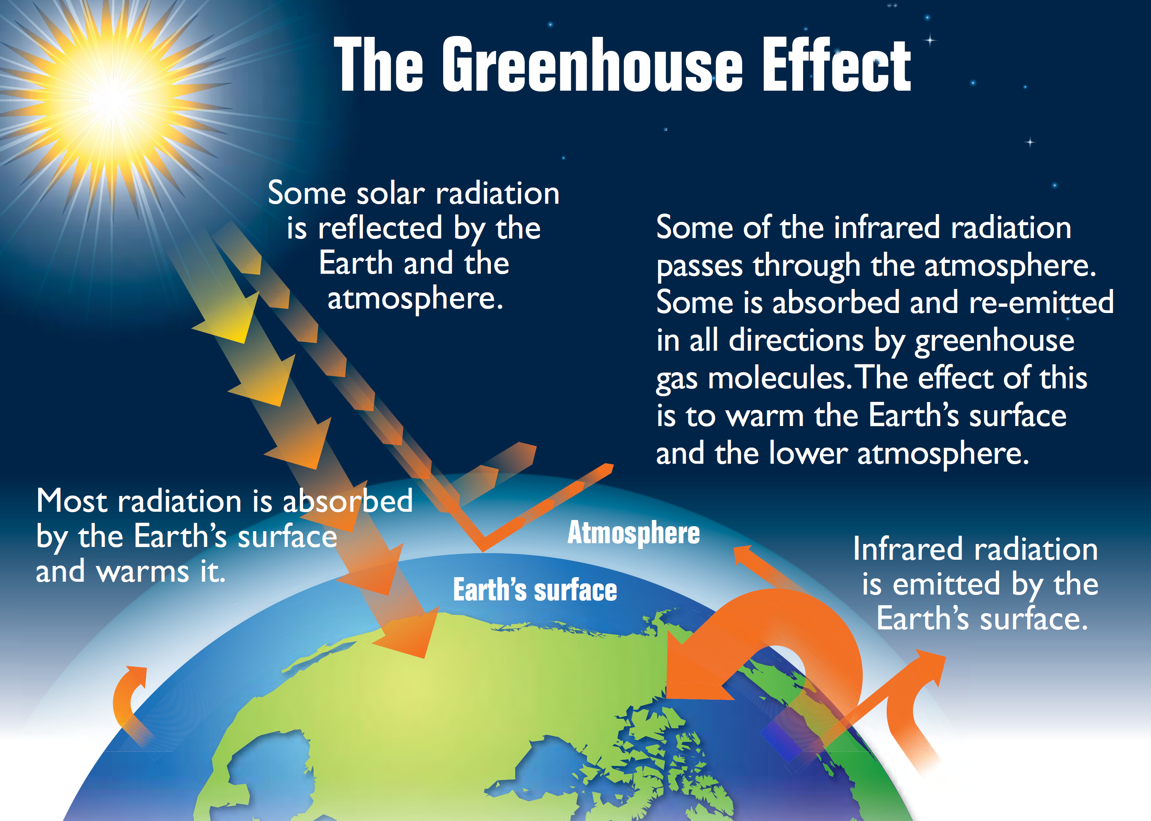
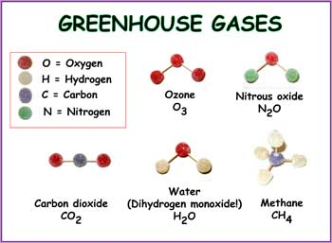
Radiation Cycle & Greenhouse Gases
The Sun emits radiation that is absorbed by Earth’s surface; this gets re-emitted (IR regime) towards outer-space/atmosphere.
Greenhouse gases absorb a fraction of this re-emitted energy, trapping it inside of the climate system.
Greenhouse gases (GHG) are strong absorbers of Infrared radiation; they prevent the energy emitted by Earth’s surface from escaping into outer-space; causing the planet’s temperature to rise. Carbon Dioxide (CO2) is the most prominent GHG in our atmosphere today.

Slide 4
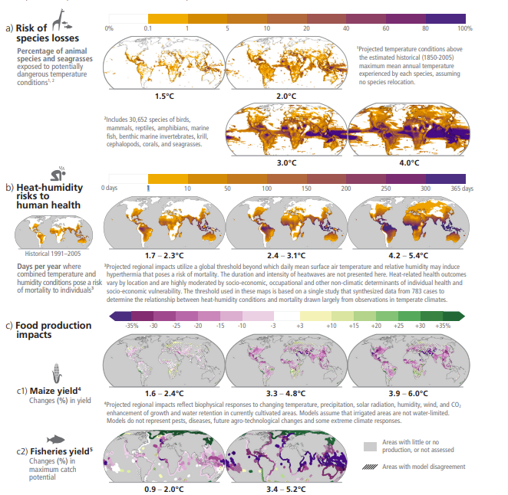
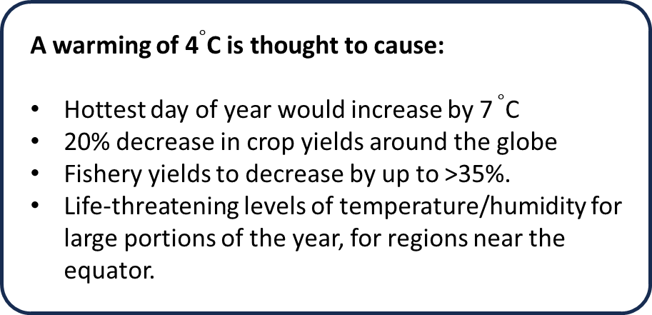
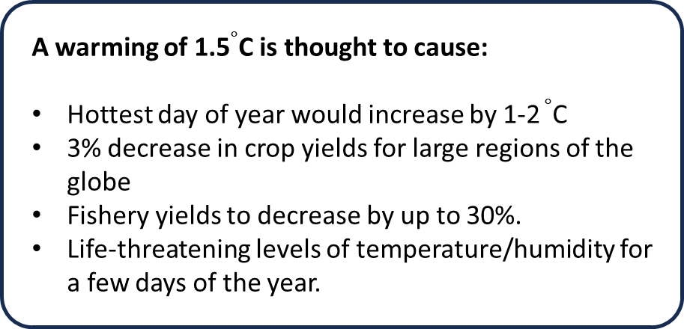
Contemporary Climate Research | IPCC 2023 Climate Report
A warming of 1.5$∘$C is thought to cause:
Hottest day of year would increase by 1-2 $∘$C
3% decrease in crop yields for large regions of the globe
Fishery yields to decrease by up to 30%.
Life-threatening levels of temperature/humidity for a few days of the year.
A warming of 4$∘$C is thought to cause:
Hottest day of year would increase by 7 $∘$C
20% decrease in crop yields around the globe
Fishery yields to decrease by up to >35%.
Life-threatening levels of temperature/humidity for large portions of the year, for regions near the equator.

Slide 5
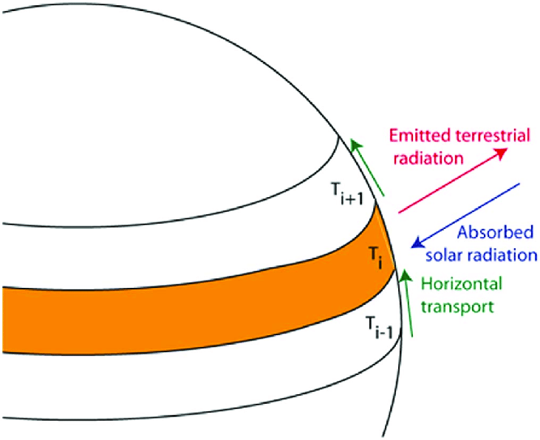
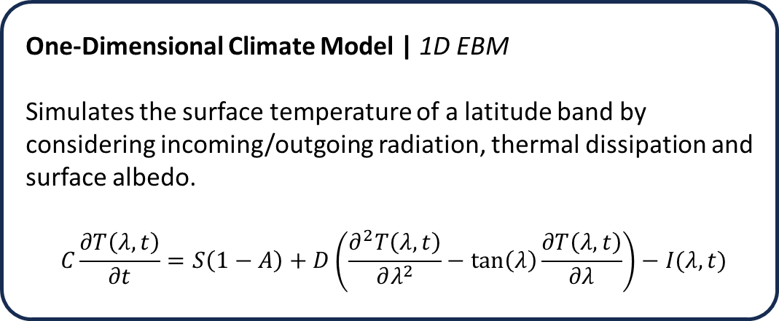
Climate Model Classes
One-Dimensional Climate Model | 1D EBM
Simulates the surface temperature of a latitude band by considering incoming/outgoing radiation, thermal dissipation and surface albedo.
$$C\frac{∂T\left(λ, t\right)}{∂t}=S\left(1−A\right)+D\left(\frac{∂^{2}T\left(λ, t\right)}{∂λ^{2}}−\tan\left(λ\right)\frac{∂T\left(λ, t\right)}{∂λ}\right)−I(λ,t)$$

Slide 6
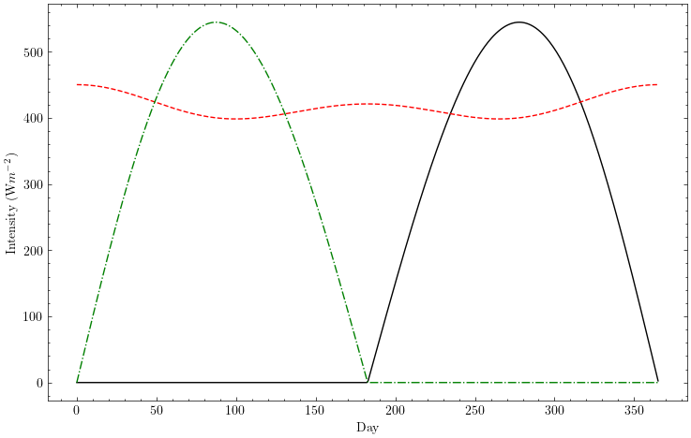
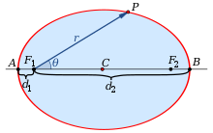
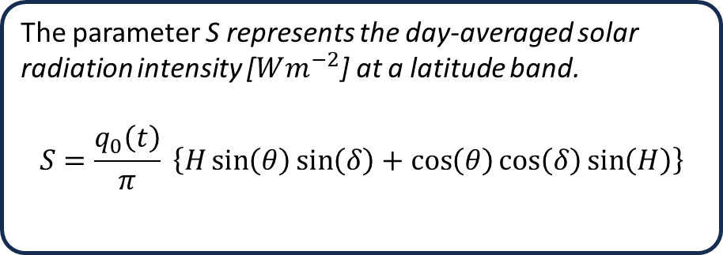
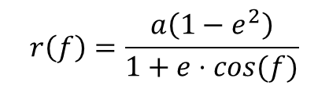
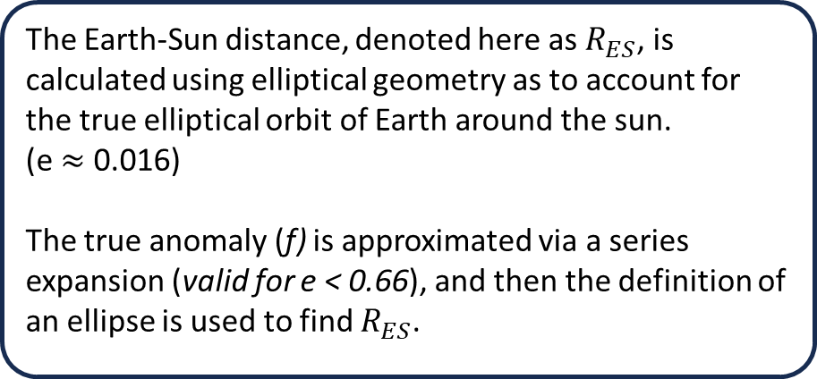
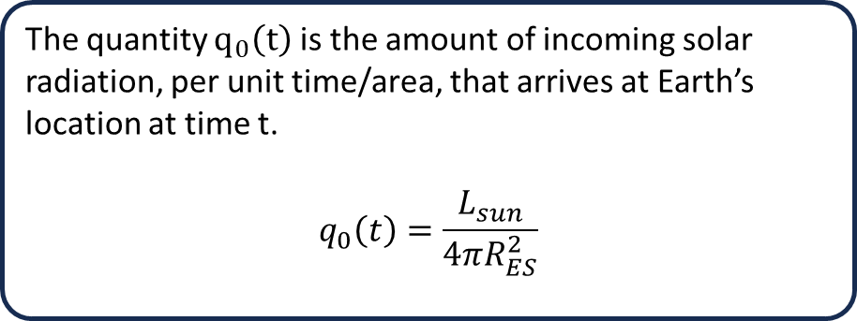
1D EBM | Solar Radiation
The parameter S represents the day-averaged solar radiation intensity [$Wm^{−2}$] at a latitude band.
$$S=\frac{q_{0}\left(t\right)}{π} \left\{H\sin\left(θ\right)\sin\left(δ\right)+\cos\left(θ\right)\cos\left(δ\right)\sin\left(H\right)\right\}$$
The Earth-Sun distance, denoted here as $R_{ES}$, is calculated using elliptical geometry as to account for the true elliptical orbit of Earth around the sun.
(e $≈$ 0.016)
The true anomaly (f) is approximated via a series expansion (valid for e < 0.66), and then the definition of an ellipse is used to find $R_{ES}$.
The quantity $q_{0}\left(t\right)$ is the amount of incoming solar radiation, per unit time/area, that arrives at Earth’s location at time t.
$$q_{0}\left(t\right)=\frac{L_{sun}}{4πR_{ES}^{2}}$$
$$r\left(f\right)=\frac{a\left(1−e^{2}\right)}{1+e⋅cos(f)}$$

Slide 7
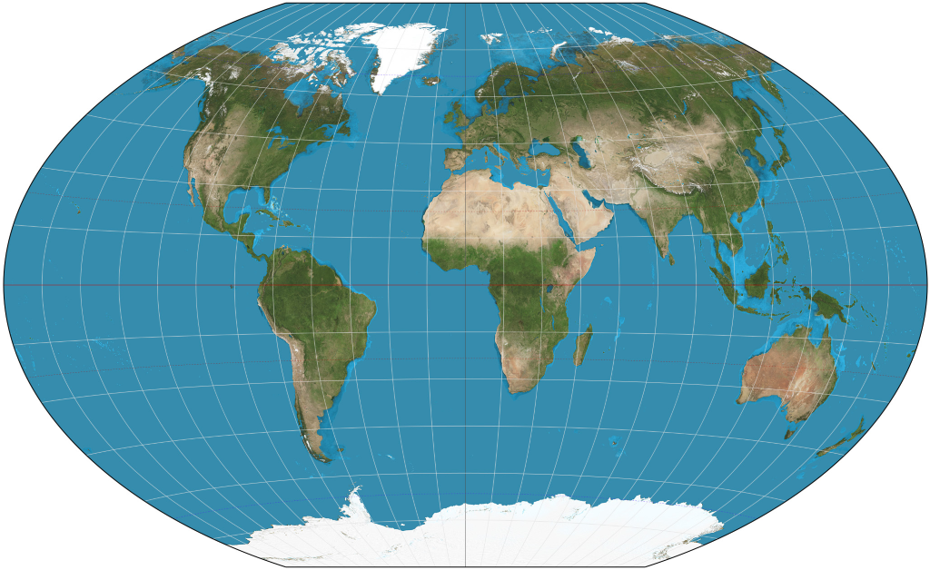
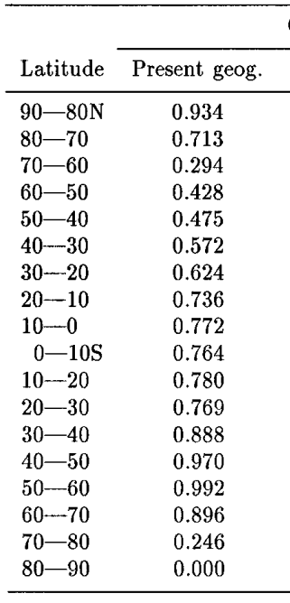
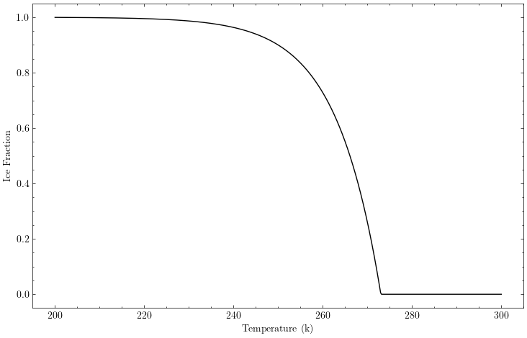
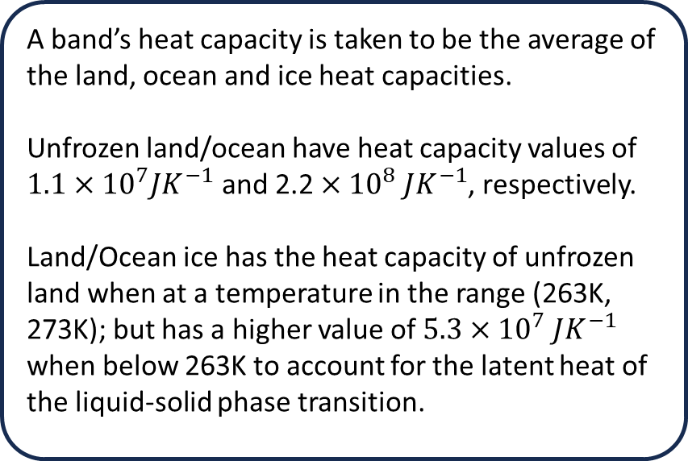
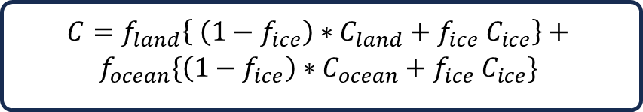
1D EBM | Heat Capacity Model
The Heat capacity (C) of a latitude band, tells us how much thermal energy is required for the band’s temperature to change by 1 degree Kelvin.
$$C=f_{land}\left\{ \left(1−f_{ice}\right)∗C_{land}+f_{ice}{ C}_{ice}\right\}+$$
$$f_{ocean}\{\left(1−f_{ice}\right)∗C_{ocean}+f_{ice} C_{ice}\}$$
A band’s heat capacity is taken to be the average of the land, ocean and ice heat capacities.
Unfrozen land/ocean have heat capacity values of $1.1×{10}^{7}JK^{−1}$ and $\text{2.2}×{10}^{8} JK^{−1}$, respectively.
Land/Ocean ice has the heat capacity of unfrozen land when at a temperature in the range (263K, 273K); but has a higher value of $5.3×{10}^{7} JK^{−1}$ when below 263K to account for the latent heat of the liquid-solid phase transition.

Slide 8
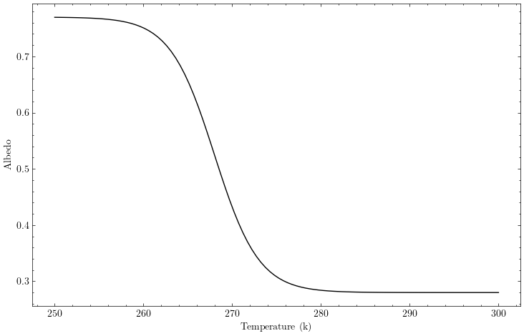

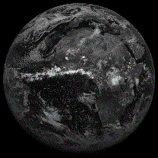
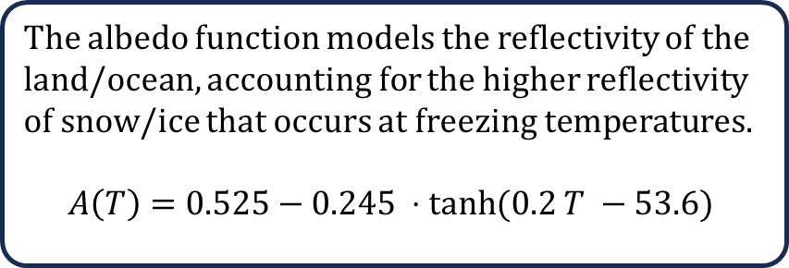
1D EBM | Albedo Model
The albedo function models the reflectivity of the land/ocean, accounting for the higher reflectivity of snow/ice that occurs at freezing temperatures.
$$A\left(T\right)=0.525−0.245 ⋅tanh⁡(0.2 T −53.6)$$
A(Ice) = 0.7 (high reflectance)
A(land/ocean) = 0.3 (low reflectance)
Future Work: Possible work could be done to include the effect that atmospheric cloud cover has on the albedo of a latitude band

Slide 9
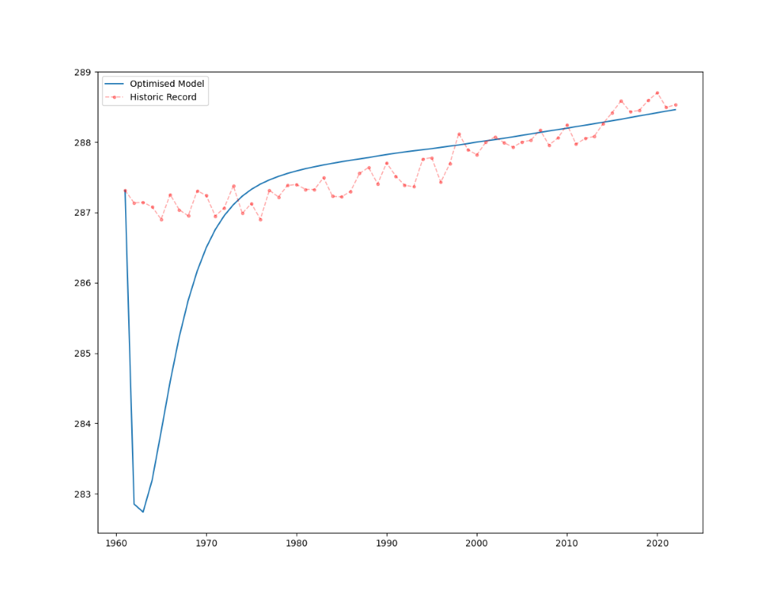
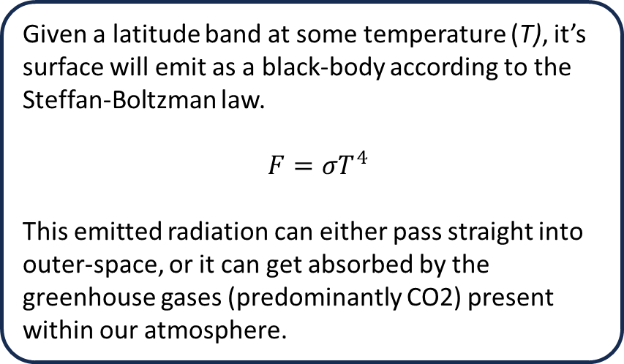
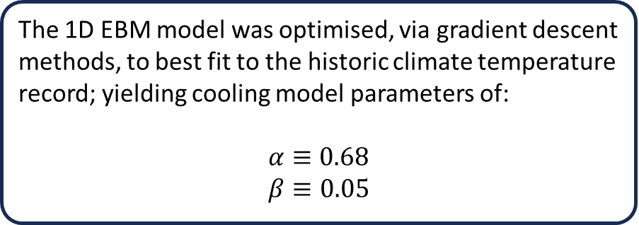
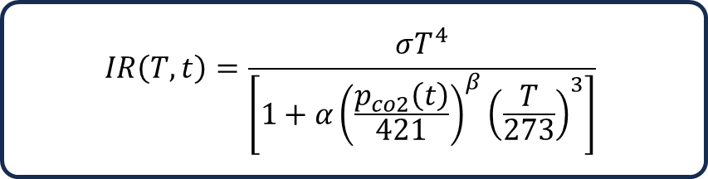
1D EBM | Infrared Cooling Model
The IR Cooling model describes the amount of (IR) radiation, emitted by Earth’s surface, that escapes into outer-space.
The 1D EBM model was optimised, via gradient descent methods, to best fit to the historic climate temperature record; yielding cooling model parameters of:
$$α≡0.68$$
$$β≡0.05$$
Given a latitude band at some temperature (T), it’s surface will emit as a black-body according to the Steffan-Boltzman law.
$F=σT^{4}$
This emitted radiation can either pass straight into outer-space, or it can get absorbed by the greenhouse gases (predominantly CO2) present within our atmosphere.
$$IR\left(T, t\right)=\frac{σT^{4}}{\left[1+α{\left(\frac{p_{co2}\left(t\right)}{421}\right)}^{β}{\left(\frac{T}{273}\right)}^{3}\right]}$$

Slide 10
1D EBM | Next Steps
Next Steps:
Investigate the albedo function to see if it can be improved in a significant way (maybe add cloud cover)
Project CO2 atmospheric concentrations into the future, under various IPCC SRES scenarios.
Use the model to simulate how the global average temperature will grow, under these different emission pathways.
Develop a strategy to extract ice sheet volume from the model, and from this, predict sea level rises for each emission pathway.

